Slide 1


Applied Data Science
Dr. Payal Varangaonkar
Assistant Professor
Department of Electronics and Computer Engineering
K. J. Somaiya College of Engineering
Somaiya Vidyavihar University

Slide 2
Module No. 1 Introduction to Applied Data Science and Data Scraping

Slide 3
Contents
Datafication- Data everywhere
Big Data
What is Data Science?
Big Data and Data Science
Current landscape of perspectives
Data Scientist Skill sets
Challenges and skill Sets needed and various applications areas.
Impact of applying Data Science in business scenario
Estimation and validation for added value due to data science

Slide 4

Data is every where

Slide 5
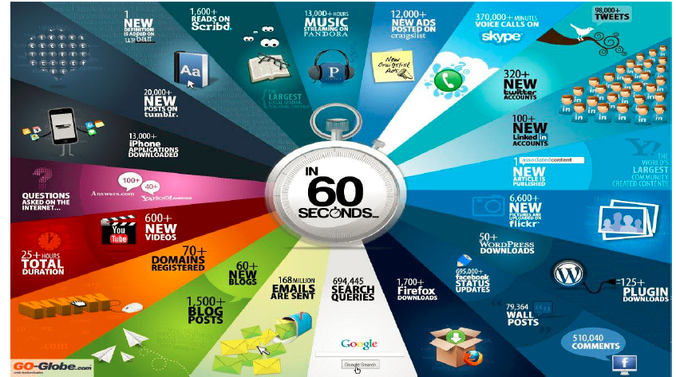
Datafication

Slide 6
Datafication
Definition
Example
Datafication is a technological trend turning many aspects of our life into data which is subsequently transferred into information realized as a new form of value
Quantify friends with ‘likes’
Googles augmented reality glass to quantify the gaze
Twitter datify the thoughts
LinkedIn datify our professional networks
Browsing web, unintentionaly with cookies
Walk in store, street we are datafied via sensors, cameras, google glasses
Taking part of social media experiment

Slide 7
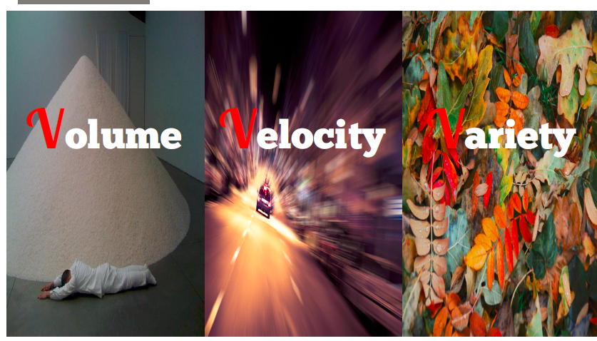
Big Data

Slide 8
Additional V- Veracity
Note: Veracity - conformity to facts; accuracy.

Slide 9
Big Data Definition

Slide 15
What is Data Science

Slide 16

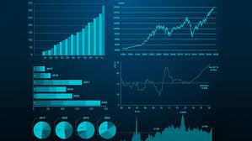

What is Data Science?
Data Science is a science of analyzing raw data using statistics and machine learning with the purpose of drawing conclusion about the information.
Data Science is used in many industries to allow them to make better business decisions and in sciences to test model and theories.
This requires process of inspecting, cleaning, transforming, modeling, analyzing an interpreting raw data.

Slide 17
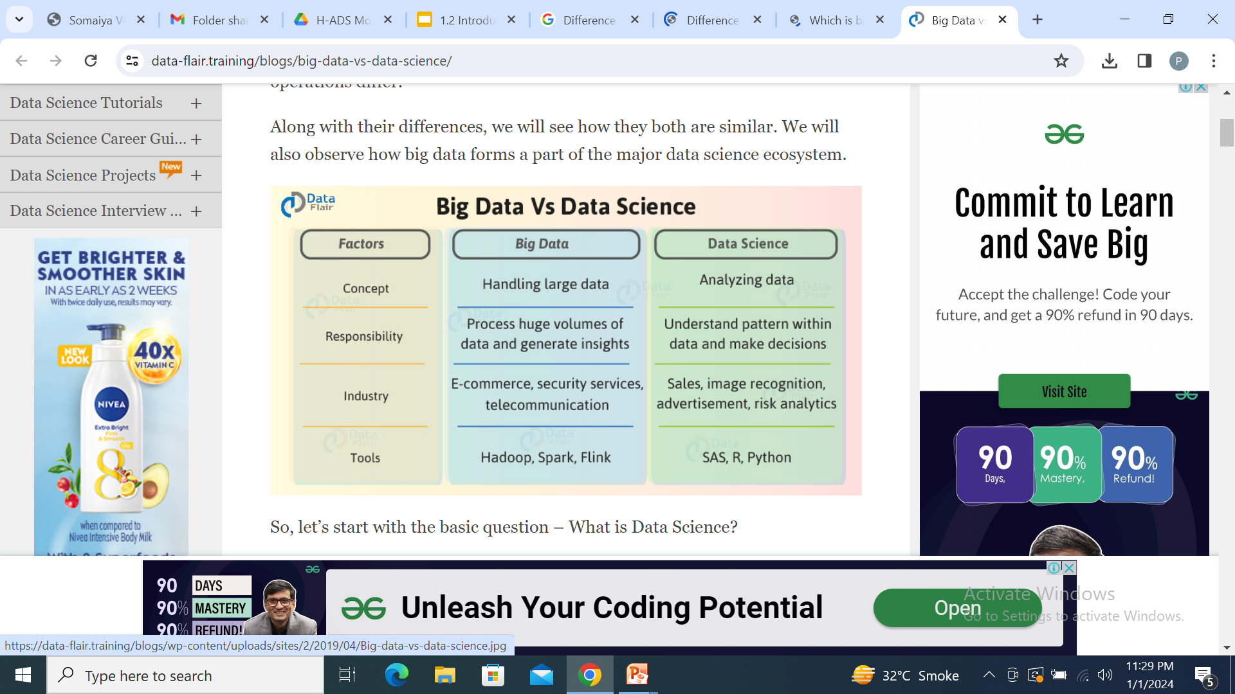

Slide 18
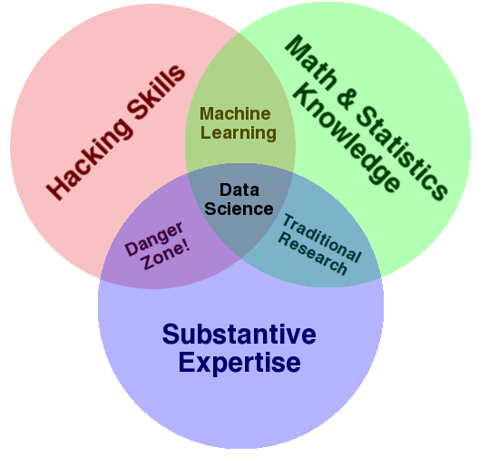
Drew Conway’s Venn diagram of data science

Slide 19
Big Data vs Data science

Slide 20
A Data Science Profile
Computer Science
Math
Statistics
Machine learning
Domain expertise
Communication and presentation skills
Data Visualization

Slide 21
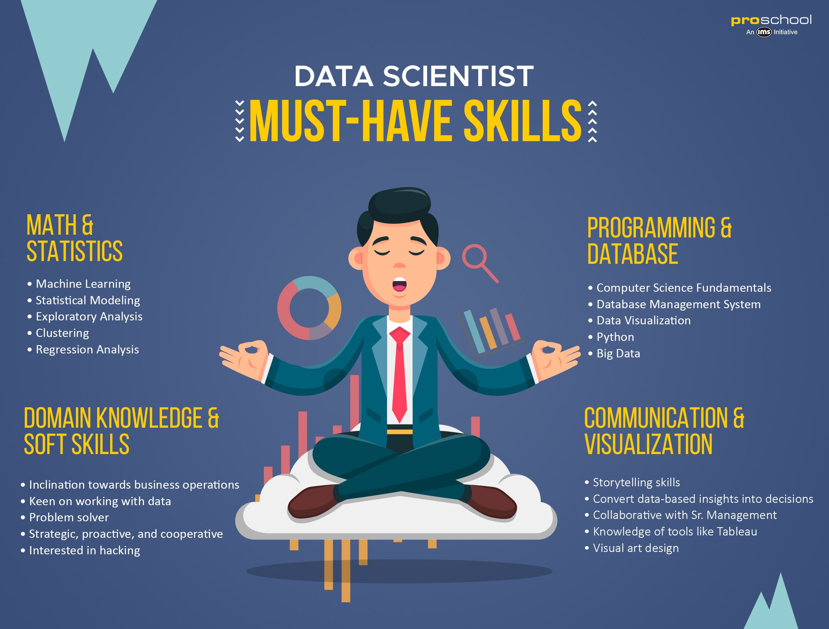

Slide 22
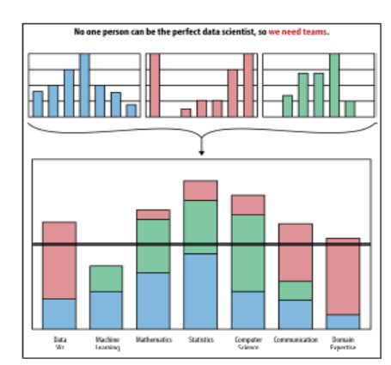
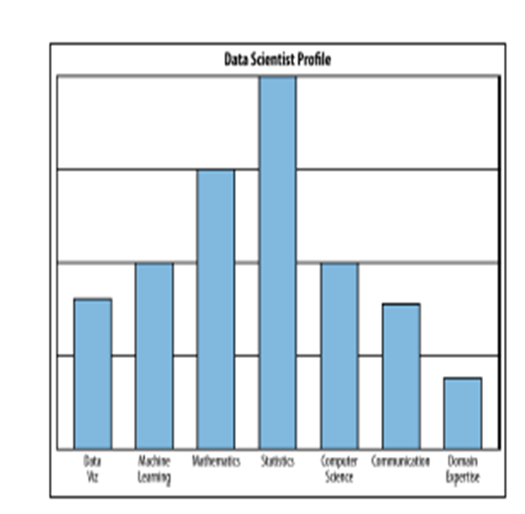
Data Science team profile
A Data Scientist Profile
Data Science Team profile

Slide 23
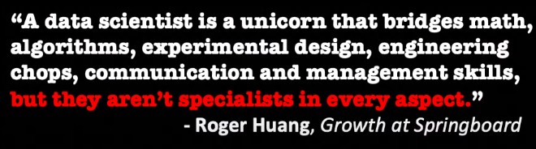
Data Scientist

Slide 24
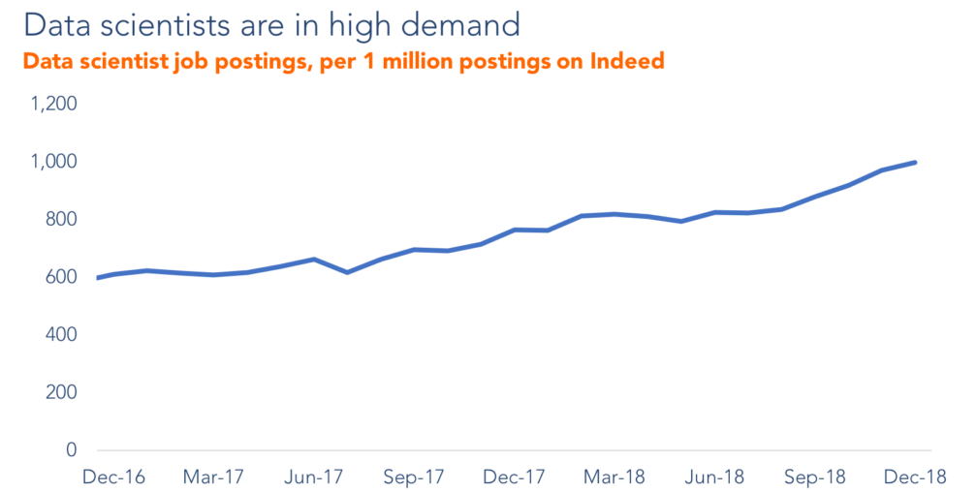

Slide 25
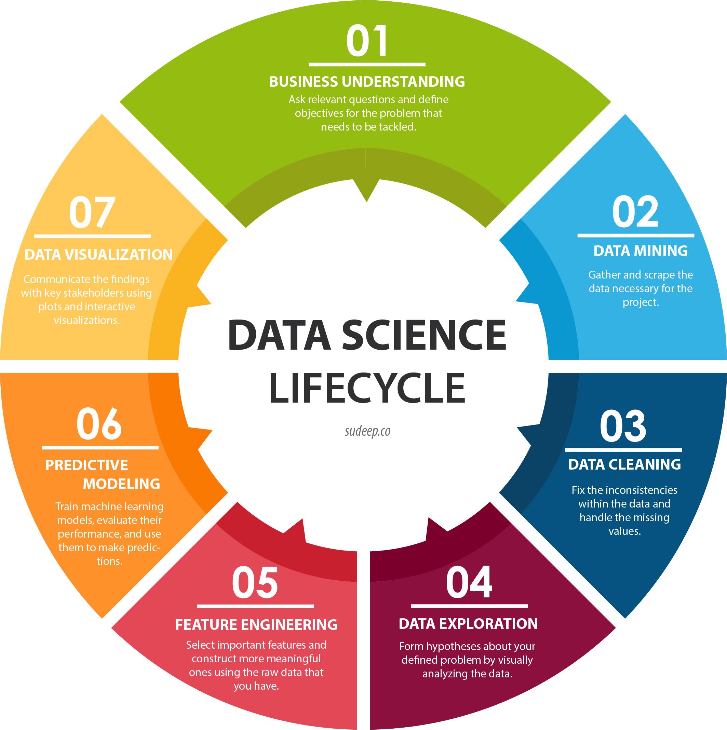
Data Science Process/Life Cycle

Slide 26
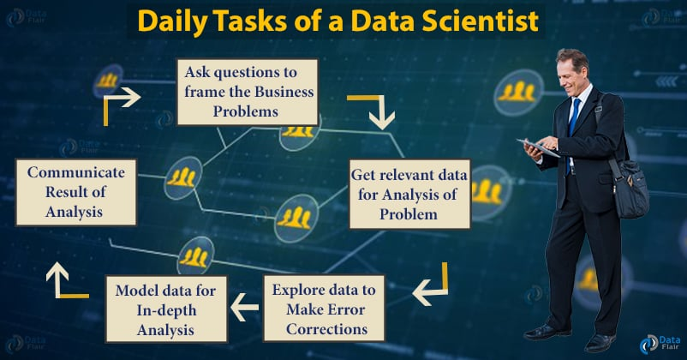
Role of Data scientist in the process

Slide 27
What does Data Scientist do Really?
In Industry:
More generally someone who knows:
How to design experiments?
Knows the process of collecting, cleaning and munging data
Skills that are necessary for understanding the biases in the data and for debugging logging output from code
Exploratory data analysis which combines visualization and data sense.
Finding patterns, build models and algorithms
Use analysis for decision making

Slide 28
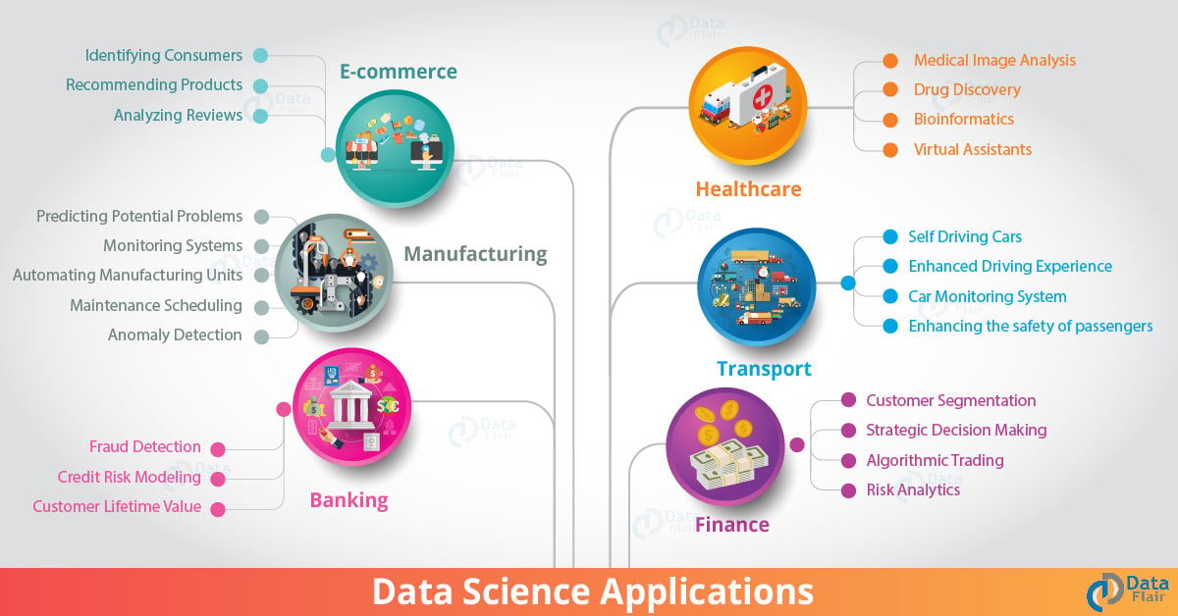
Data Science Applications

Slide 29
Question
?

Slide 30
Thank
You!!

